Slide 1
Human-Centered Artificial Intelligence (HCAI)
Kick-off

Slide 2
The world tends to be quite complex, and keeps getting more complex
More things to do, to remember, to process, to communicate...

Slide 3
The human mind is very limited
Working memory, conscious capacity, subconscious capacity, vulnerable to environment, dependent on energy level, etc...

Slide 4
How can we deal with these limitations?

Slide 5
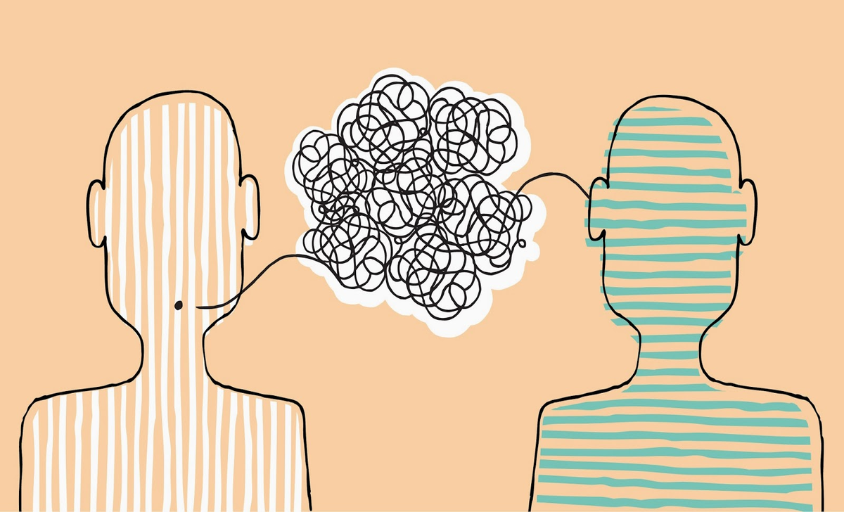
We can store information in our environment...

Slide 6
This is called, the extended mind theory
It made people more efficient and drives our civilisation!

Slide 7
But... Driven by competitive pressure, humans are driven to become more efficient...

Slide 8
Initially, people thought cellphones would horribly invasive...
But... They make people more efficient and competitive...
So people adopted them in order to remain competitive

Slide 9
Now we live in an interconnected world
Cognitive processes are coupled online, for example:
You can send messages
Other people interacting with search engines improve your access to information
Information is processed automatically
E.g. If you upload new photos to a photo respository like Google Photos, it automatically starts organizing these
Results are pushed to us by our applications
New message
Weather
Adverstisements

Slide 10
This interconnected world of information processing is called:the theory of Network-enabled cognition

Slide 11
And it’s not going to stop soon, in fact, it’s going to speed up...
But, it’s going to become more intuitive; more like real-life
Thought? Questions?

Slide 12
Human-Centered Artificial Intelligence
And now, computer applications are going to react (quasi) intelligently to us instead of just processing information...

Slide 13
What are we going to learn?
Designing Human-centered AI applications
Specifically, you will learn how to create basic prototypes by:
understanding and applying the basic design principles of user-experience design;
understanding and apply the basic processes of user-experience design;
in the context of artificial intelligence.

Slide 14
Why are we going to learn it?
Algorithms and models by themselves cannot immediately add value to consumer and business processes by themselves
Adding value can be done by:
a human interpreter; you as the analyst or data scientist, analysing, collecting data, scripting etc.;
embedding them in an application which automates these processes.
To add value with AI we need to start from a a human perspective; AI helping humans, and making choices with the user always at the center of the design and development process.
This means focussing on needs and context of the users in order to achieve better results when it comes to the fit of a technical system in people’s everyday lives.

Slide 15
How are we going to learn it?
By:
developing a wireframe prototype using various iterative testing methodologies, design techniques and processes;
explicitly involving stakeholders in the design and testing of application;
creating a remote user test from your wireframe prototype;
designing an appropriate user experience to facilitate artificial intelligence/data science applications;
designing for and communicating about various disruptive technology risks;
justifying design decisions using basic design principles of user-experience design.

Slide 16
What are you going to deliver?
A live demo (online or offline) of the wireframe prototype created of the app where the lecturer will act as the client to which the app is demonstrated to. The wireframe will be assessed on the user-experience and the value created by the app.
User-experience defined as:
Interaction flow
Interaction quality
Intuitive user understanding (of presented data & interactions)
Value defined as:
Client appreciation
Useful features
Holistically effective for the target audience
The value of the data analysis to the features
Management of disruptive technology risks

Slide 17
Okay...
But what does that mean for me concretely?
A live demo of what?
How does that look like?

Slide 18
Like this:
We’ll use Proto.io
It’s like an interactive powerpoint
You can click on it
Add audio, effects, movies etc.
You can share it online
Collect data
It’s easy to use and let’s you test and play with different designs before building the real-deal

Slide 19
We’ll go more in depth tomorrow in Datalab and do a tutorial!

Slide 20
Where are we now with the creative brief?

Slide 21
How are you going to be assessed?
Designing Human-centered AI applications
Operationalized for assessment in:
ILO 5. Design, Prototyping and Implementation:
The student can develop a wireframe prototype for an application embedding a novel algorithm using various design techniques, iteratively testing his design and explicitly involving stakeholders in the process.

Slide 22
Practical Information
Originally, 10 days consecutive days of Self-Study Days and Data Lab Days where:
Self-study day of (max) 8 hours course day, 6 days in total, structured as follow:
Github instructions/Video-lecture for presenting and discussing the main concepts, using practical examples and online material: 1 – 4 hours
(Interactive) Excercises, at home with lecturer support: 4 - 6 hours
Data lab day of 8 hours, 4 days in total: Mini-project to apply material learned in preceding Self-Study Days to a use-case (their own deep-learning algorithm) by creating a wireframe prototype.
Scope reduction; Block C impediments:
Good Friday
Staff study-day
Deep learning impediments
Now, 8 days where:
More lectures: e.g. the last 2 self-study days not given but are surmised in a lectures in the first datalab day
GDPR is scrapped from the module
High-quality user-feedback isn’t covered and not expected as deliverable

Slide 23
Practical Information
The stand-ups will revolve around the preparation for the data labs and learning objectives of the self-study days.​
Community learning – ask your peers!​
If topics are still unclear, please contact us in the Datalab!
!!DataLab days require preparation!!​

Slide 24
Questions?

